Slide 1


Dept. of CS&E ( DATA SCIENCE)
Adichunchanagiri Institute of Technology Chikkamagaluru - 577102
Mini Project –Presentation
On
“BiblioTrack -An AI-Powered Bookstore ”
Group Number - 01
Presented By,
Harshitha S (4AI23CD019)
Prajna K S (4AI23CD038)
Ramya Manjunath Gouda (4AI23CD041)
Shalini M B (4AI23CD048)
Under the Guidance Of,
Prof.Gagana Deepa J
Asst. Professor
Dept of Data Science
AIT, Chikkamagaluru

Slide 2
Contents
Problem definition
Scope of the Project
Project Design
Methodology
Tools And Technology
Implementation
Challenges faced
Result
Conclusion
Future Work

Slide 3
Problem Statement
To design an AI-powered online bookstore that overcomes the limitations of existing systems, which mainly focus only on search and purchase. The system will provide intelligent recommendations, interactive features, and personalized suggestions to help users easily discover books and connect with peers.

Slide 4
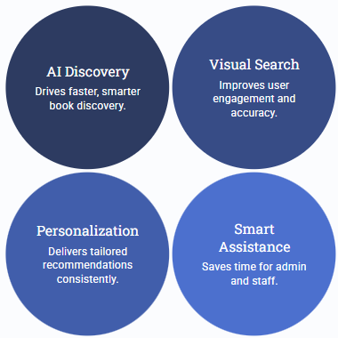
Scope of the Project
Focus Area:
AI Driven Book Discovery
Visual Search Integration
Personalized Recommendations
Smart User assistance
Efficient Inventory and Admin Management
Key Benefits:
Faster and Smarter Book Discovery
Improve User Engagement
Time Saving for Admin and User
Higher Accuracy in Search Results
Enhance Decision Making Through Analytics

Slide 5
Project Design
Frontend: Web interface for browsing and managing books.
Backend: Handles data processing, authentication, and business logic.
Database: Stores books, orders and users details
Modules:
Book Management
Category & Author Management
Order & Inventory Management
User/Customer Module
Admin Dashboard

Slide 6
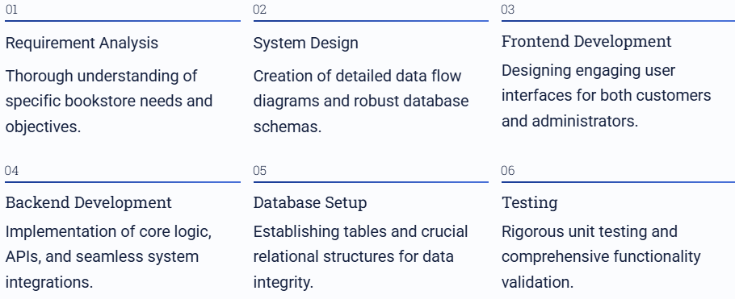
Methodology

Slide 7

Tools and Technologies
Framework : Django(Python)
Frontend : HTML, CSS, JavaScript
Backend :Django MVC Architecture
Database : SQLite
AI&ML : TensorFlow.js

Slide 8
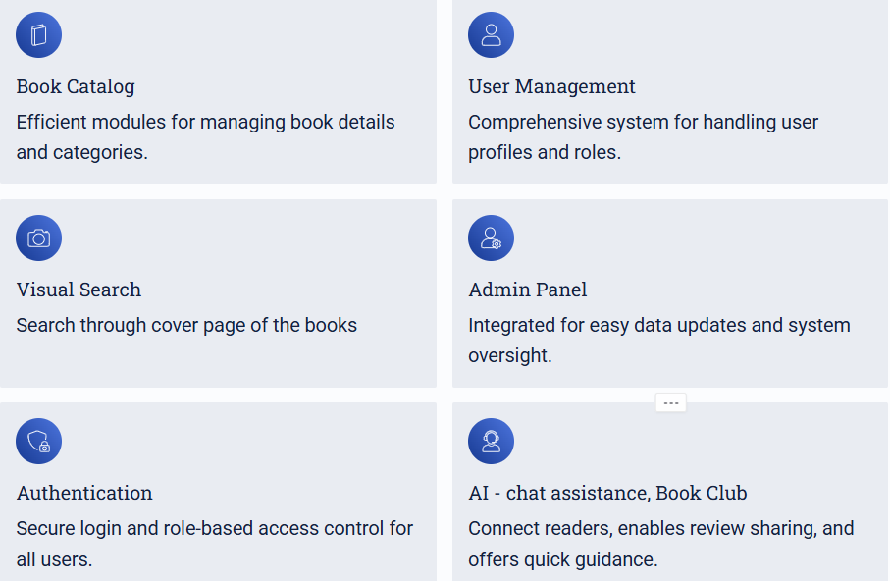
Implementation

Slide 9
Challenges Faced
Integrating multiple AI modalities (recommendation, visual search, chatbot) into a cohesive platform.
Ensuring real-time performance and scalability for AI-driven features.
Designing a user-friendly interface that gracefully handles complex functionalities.
Moderating community content automatically

Slide 10
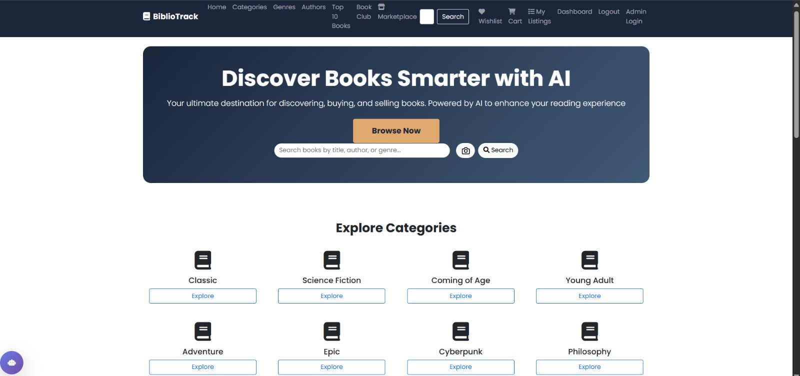
Result

Slide 11
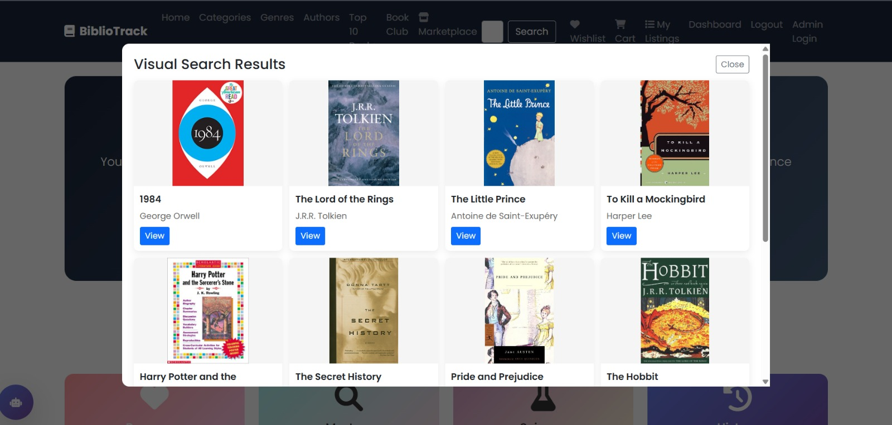
Result

Slide 12
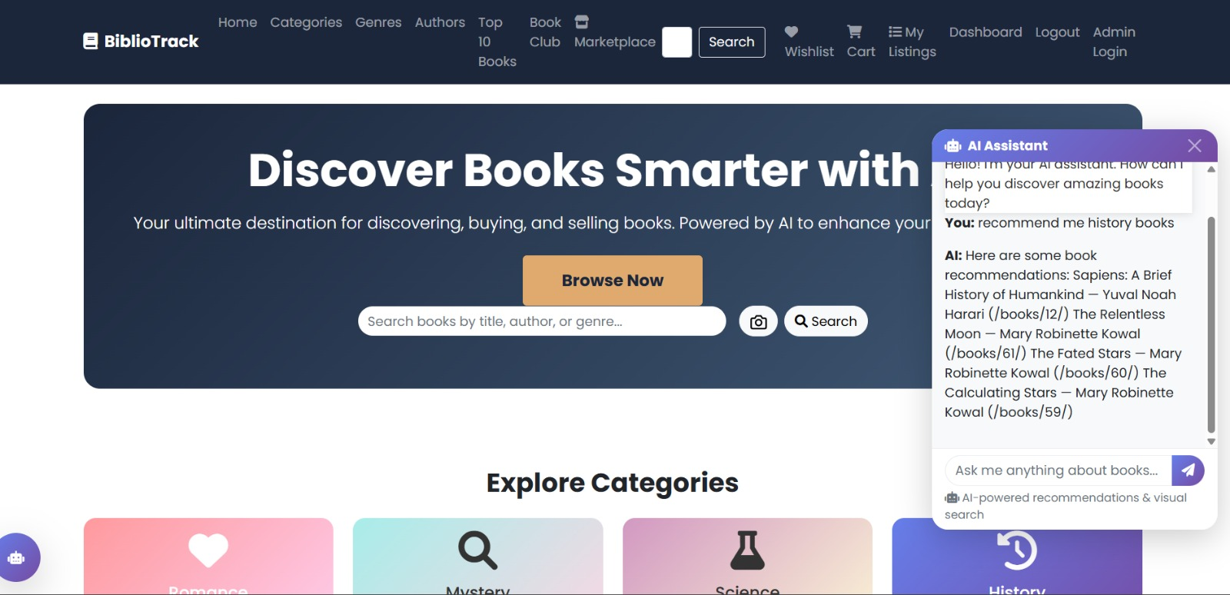
Result

Slide 13
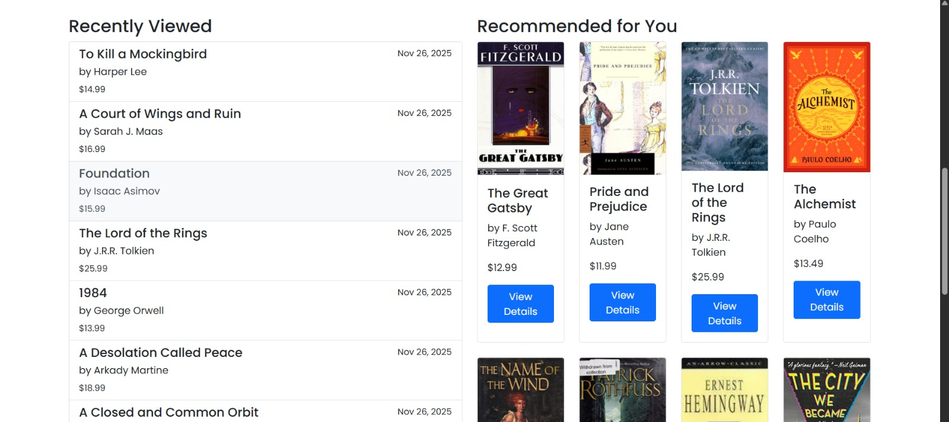
Result

Slide 14
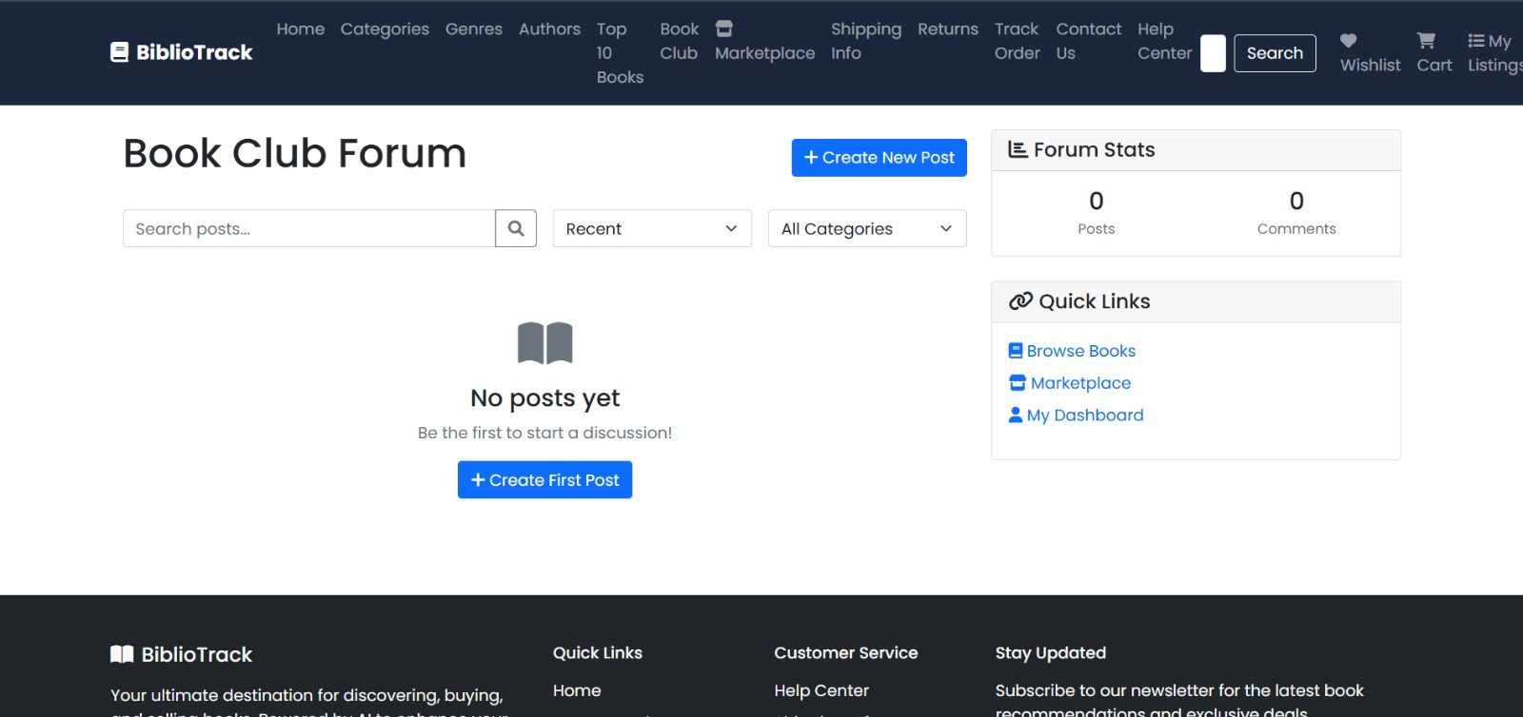
Result

Slide 15
Conclusion
BiblioTrack effectively supports users in discovering, tracking, and engaging with books.
AI-powered chatbot assistance adds significant value through personalized support.
Visual search and community book club for social engagement..
The project combines e-commerce, community, and AI technologies to offer a comprehensive book platform.

Slide 16
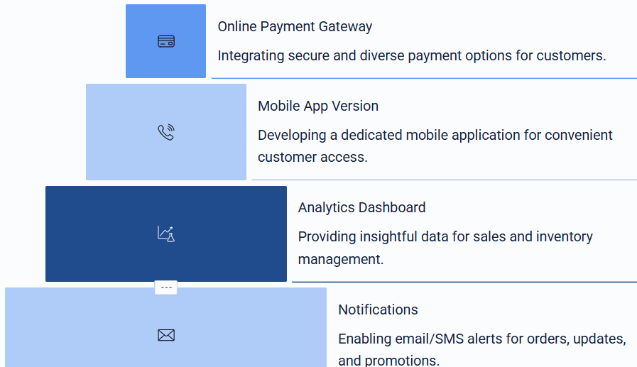
Future Work

Slide 17
GitHub Link
Harshitha S : https://github.com/harshithasathish
Prajna K S : https://github.com/prajnaks22
Ramya Manjunath Gouda: https://github.com/Ramyagouda
Shalini M B : https://github.com/SHALINIMB18

Slide 18
ThankYou!!!

